Slide 1
INTERVIEW TRAINER ai agent
IBM HACKATHON PROJECT
Presented By: Shouvik Dutta
College Name & Department : B.P Poddar Institute of Management and Technology.
TECHNOLOGY: Computer Science and Engineering

Slide 2
OUTLINE
Problem Statement
IBM Cloud Services Used
Technology used
Wow factor
End users
Result
Conclusion
Git-hub Link
Future scope
IBM Certifications

Slide 3
Problem Statement
Challenge:
Many job seekers struggle to prepare for interviews effectively due to limited access to tailored resources.
Existing tools often lack personalization, industry relevance, and real-time updates.
Proposed Solution:
An AI Interview Trainer Agent that uses NLP and RAG on IBM watsonx.ai to:
Generate role-specific interview questions.
Provide model answers and improvement tips.
Retrieve latest industry-specific trends and expectations.

Slide 4
Technology used
IBM cloud lite services
Natural Language Processing (NLP)
Retrieval Augmented Generation (RAG)
IBM Granite Foundation model

Slide 5
IBM cloud services used
IBM watsonx.aI Studio (Agent building & configuration).
IBM Watsonx.aI runtime.
IBM Cloud Object Storage (Lite plan).
Agent Lab for asset creation & deployment .

Slide 6
Wow factors
Personalized question sets based on user profile.
Model answers & improvement tips.
Real-time knowledge retrieval using integrated tools (Google, Wikipedia, DuckDuckGo).
Vector-indexed documents for deep domain-specific grounding.
Supportive, confidence-building feedback.

Slide 7
End users
Job Seekers(freshers & experienced professionals).
Career Counsellors & Training Institutes.
Universities & Placements cells
HR Teams conducting mock interviews.

Slide 8
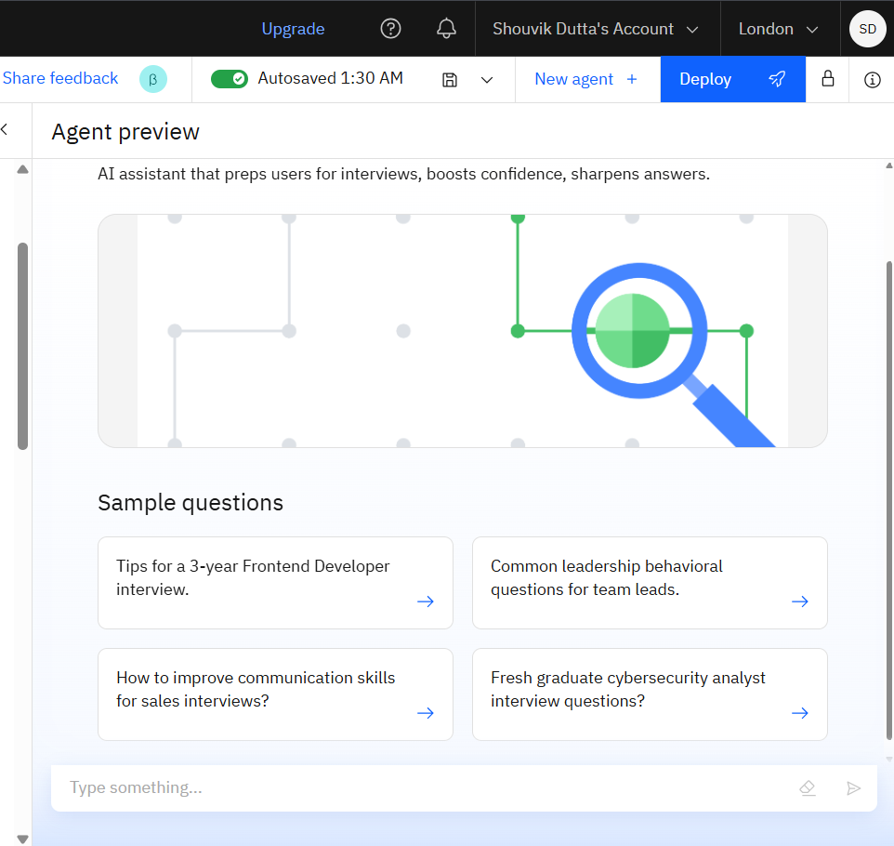
Results

Slide 9
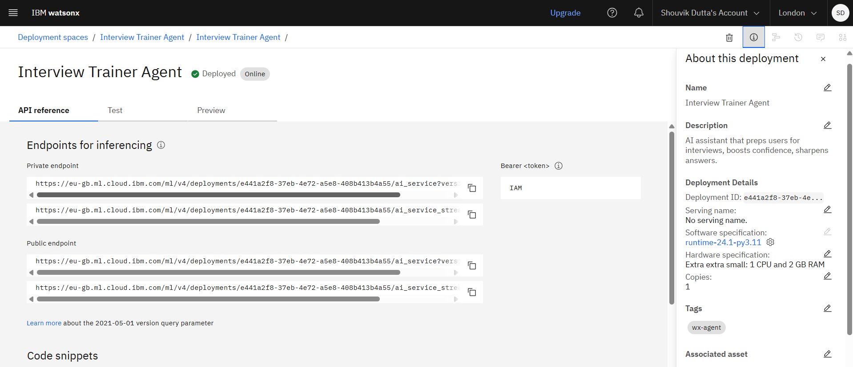
Api reference after deployment

Slide 10
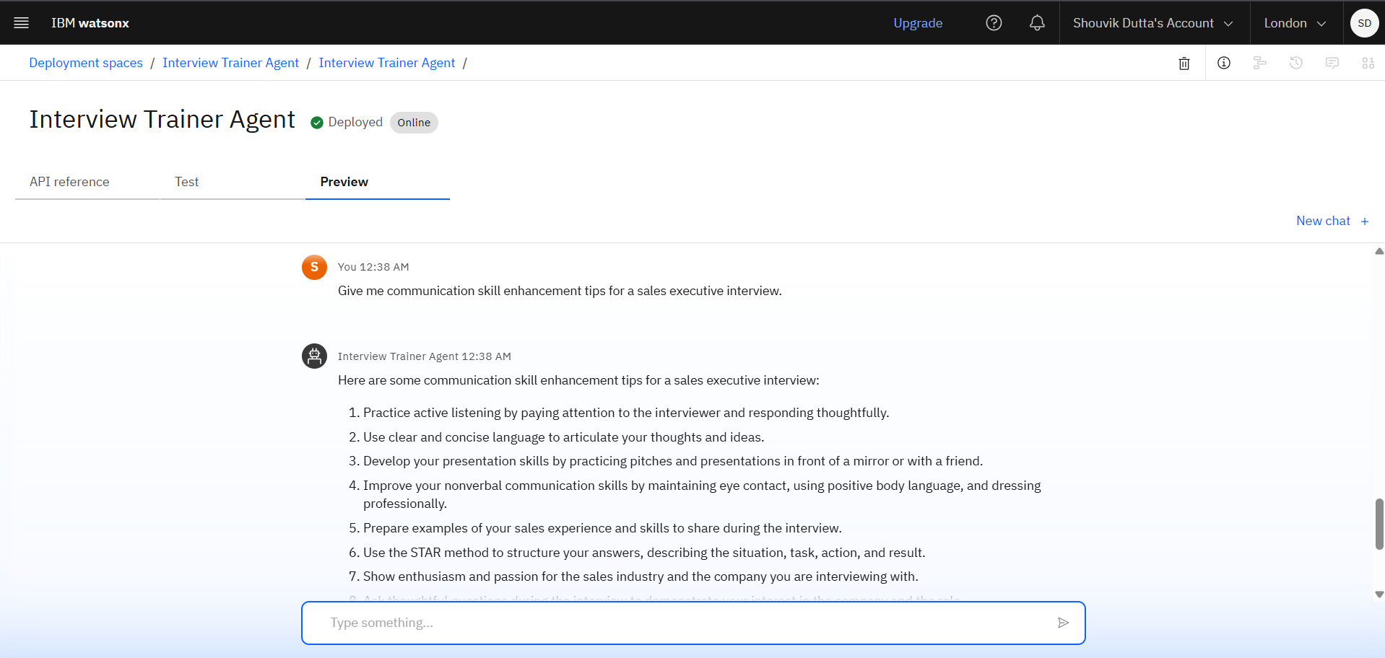
Results
Deployed AI Agent

Slide 11
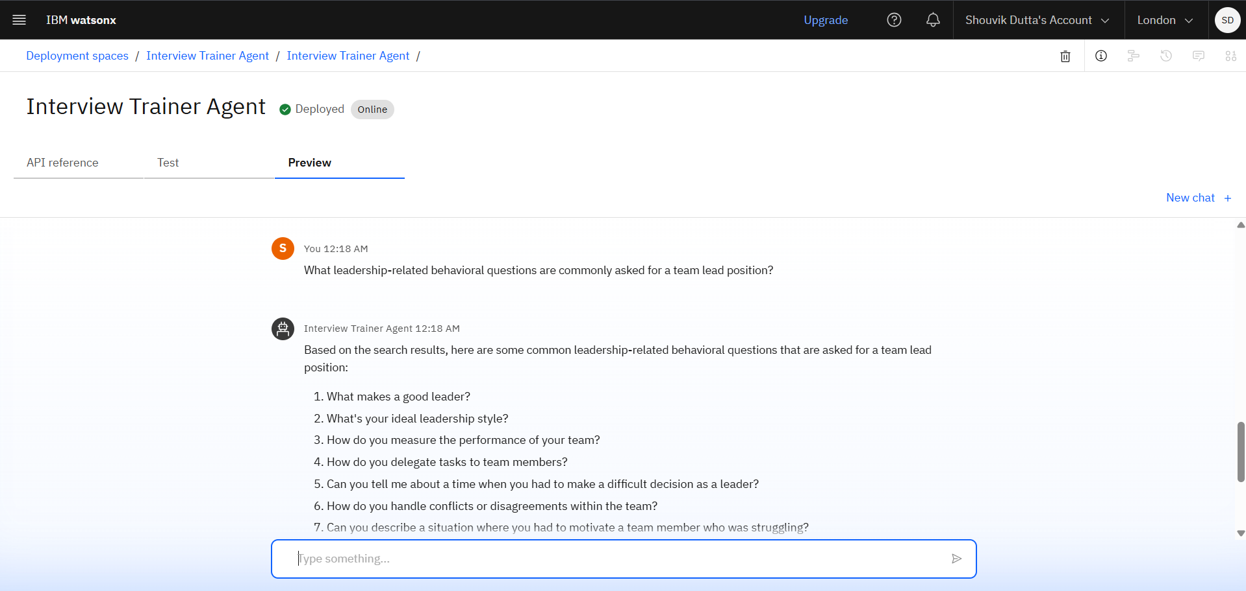
Results

Slide 12
Conclusion
Reduces preparation time significantly.
Boosts candidate confidence & performance.
Scalable for universities, corporates, and training institutes.
Can be enhanced with voice-based interactions.

Slide 13
GitHub Link
https://github.com/Shouvik-9/INTERVIEW-TRAINER-AI-AGENT-IBM-PROJECT.git

Slide 14
Future scope
Multilingual Support
Voice-based interactions.
Real-Time Collaboration (group mock interviews).
Research Gap and Novel Topic Identification
Integration with LinkedIn& other job portals for tailored feedback.

Slide 15
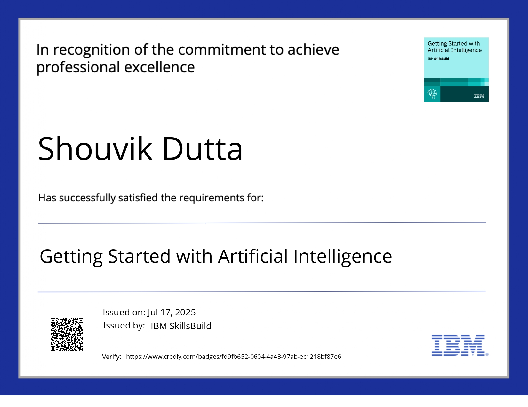
IBM Certifications

Slide 16
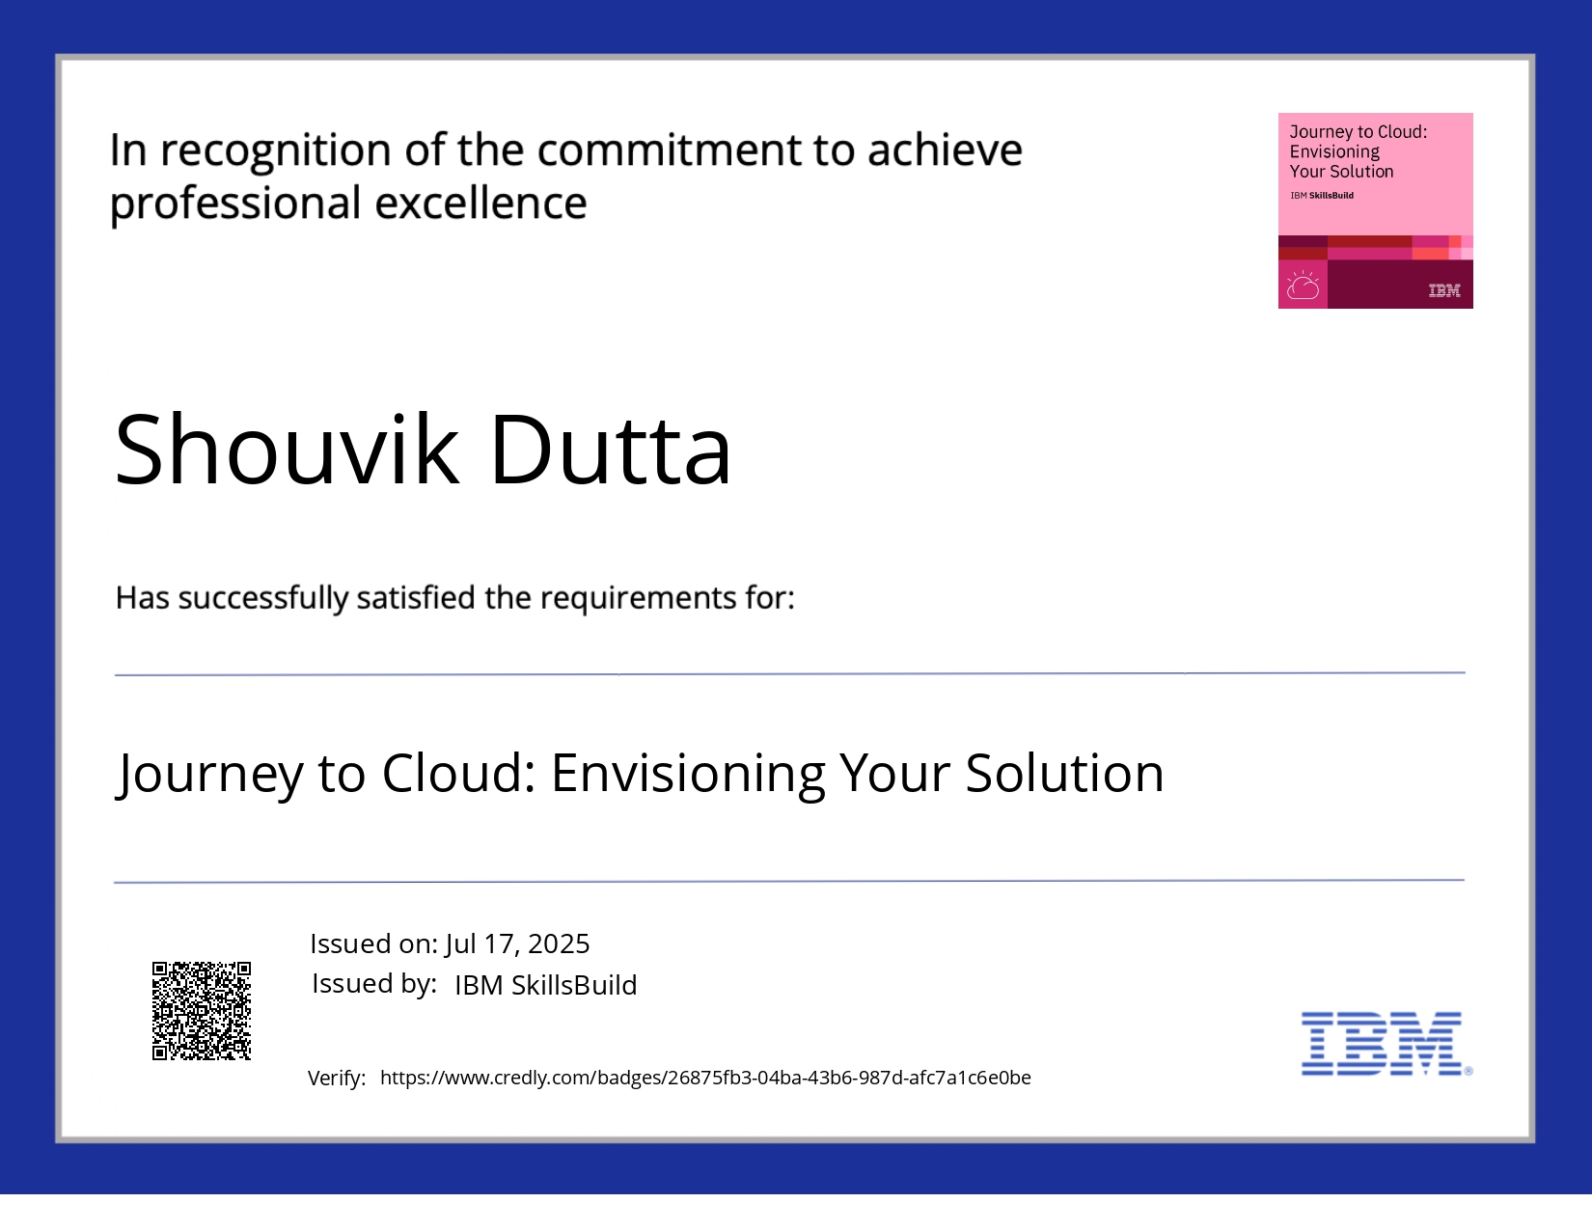
IBM Certifications

Slide 17
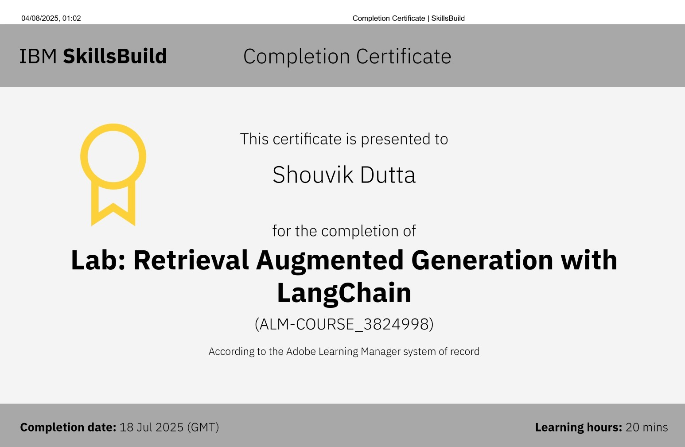
IBM Certifications

Slide 18
THANK YOU

